Slide 1
Greedy Pigs
Play a few rounds of the game “Greedy Pigs”
Game is in Connect Year 8 Library
Notes:
hook

Slide 2
Greedy Pigs Questions
What is the sample space for each roll of the dice?
What is the Pr(rolling an even number)?
What is the Pr(rolling a 5 or a 6)?
What is the Pr(rolling a 5 or a 6)?
What is the Pr(not rolling a 1)?
What were individual player strategies? What strategies seemed to work the best and why?

Slide 3
24
7
30
Date
Probability Review
EQ – What are some main concepts of Probability and how does Probability affect our life?
5
Notes:
Input

Slide 4
Lesson objective
By the end of this lesson you will be able to;
- Reinforce your knowledge of what Probability, sample space and complement is and how they can impact your daily life.
Notes:
Lesson

Slide 5
Success Criteria
You will know you are successful in achieving the objective by…
Being able to complete Dwyer Chapter 4 Review Questions

Slide 6
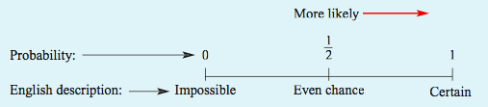
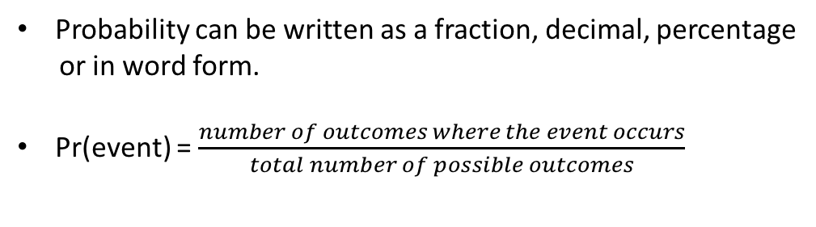
24
7
30
Date
Probability Review
EQ – What are some main concepts of Probability and how does Probability affect our life?
To review:
Simply put, probability is the chance of something happening.
Things to remember:
The probability of an event is a number between 0 and 1,
Probability can be written as a fraction, decimal, percentage
or in word form.
Pr(event) = $\frac{number of outcomes where the event occurs}{total number of possible outcomes}$
5
Notes:
Lesson objective (EQ)

Slide 7
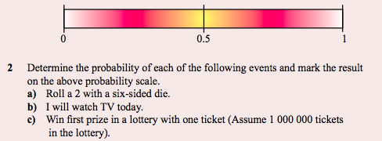

Quick Questions

Slide 8
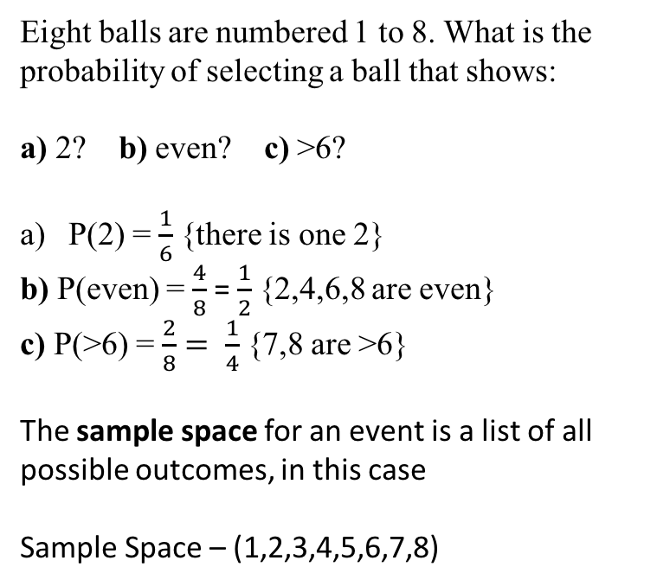
24
7
30
Date
Probability Review
EQ – What are some main concepts of Probability and how does Probability affect our life?
For Example:
Eight balls are numbered 1 to 8. What is the probability of selecting a ball that shows:
a) 2? b) even? c) >6?
P(2) = $\frac{1}{6}$ {there is one 2}
b) P(even) = $\frac{4}{8}$ = $\frac{1}{2}$ {2,4,6,8 are even}
c) P(>6) = $\frac{2}{8}= \frac{1}{4}$ {7,8 are >6}
The sample space for an event is a list of all possible outcomes, in this case
Sample Space – (1,2,3,4,5,6,7,8)
5

Slide 9


24
7
30
Date
Probability Review
EQ – What are some main concepts of Probability and how does Probability affect our life?
Consider the following:
b) Is an example of the complement of an event. The
complement of an event, E’ (or not E) is the probability that an
event won’t occur.
Ex: The complement of the event ‘rolling the number 3’ is
‘rolling a number other than 3’
Try the following question:
5

Slide 10
Check for understanding
Going around the room, popcorn-style, have
students give examples of probability that
occur daily in their lives.
Notes:
Check for understanding

Slide 11
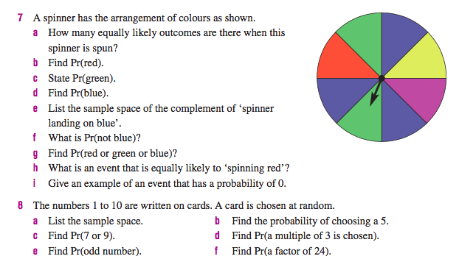
Guided Practice
Notes:
Guided practice

Slide 12
Extension – Multiple Events
A coin is flipped and then a dice is rolled. Create a
table that reflects all possible outcomes of these
two events.
Notes:
Independent practice

